Slide 1
Dimensionality Reduction

Slide 2
Dimensionality Reduction
A preprocessing step that may be required for:
Visualization of the data.
Finding the intrinsic dimensions (features)
Many applications have a large number of features that may be redundant, irrelevant or sparse (e.g text documents where features are words)
Number of samples are much smaller than number of dimensions making learning at a desired resolution not feasible (curse of dimensionality).
Reducing costs of training and learning algorithms
Reducing storage and future measurement costs
Material was collected from multiple sources; chief among them Mohamed Kamel’s ECE 750 lecture notes.

Slide 3
Dimensionality Reduction
A preprocessing step that may be required for:
Visualization of the data.
Finding the intrinsic dimensions (features)
Many applications have a large number of features that may be redundant, irrelevant or sparse (e.g text documents where features are words)
Number of samples are much smaller than number of dimensions making learning at a desired resolution not feasible (curse of dimensionality).
Reducing costs of training and learning algorithms
Reducing storage and future measurement costs

Slide 4
Dimensionality Reduction
Curse of Dimensionality
A term introduced by Richard Bellman to illustrate the explosion of the samples required when we have higher dimensions.
The number of samples required to fully represent a 10 valued one dimension=10.
For 20 dimensions we will need 1020.
The number of samples grows exponential in terms of the dimensions.
This poses a problem for non parametric learning algorithms (such as classification) that require training samples.

Slide 5
Dimensionality Reduction
Peaking Phenomenon
For a fixed number of samples increasing the number of features may degrade the performance

Slide 6
Feature Extraction and Feature Selection
Feature Extraction combines by transformation or projection of the original features into a new set of features.
Ideally the transformation or the projection is according to an objective that helps finding the significant set of new features of lowers dimensions than the original set of features
Sometimes the transformation produce new features that may have some relevant meaning to the data but many projection cases produce features that are difficult to interpret or relate to the meanings of the original features.

Slide 7
Feature Extraction and Feature Selection
Some methods for feature extraction include:
Linear methods:
Unsupervised (no class label information, e.g .PCA, ICA)
Supervised (class labels know, e.g LDA)
Nonlinear methods
Global (preserves global properties, eg. MDS, Isomap, Kernel PCA)
Local (preserves properties within local neighborhood, e.g. LLE)

Slide 8
Feature Extraction and Feature Selection
Feature Selection which finds a subset of the original features according to some criteria.
Ideally the selected subset includes the significant features and eliminates irrelevant and redundant features.
The selected features being a subset of the original are interpretable and keep their original meaning.
Approaches include
Feature Ranking
Subset Selection which includes:
Wrapper approach
Filter approach
Both use search strategies such as:
Exhaustive
Sequential (Forward or Backward)
Other

Slide 9
Feature Extraction Methods: Linear Projection
Principal Component Analysis PCA: The main idea is that high information corresponds to high variance (more discriminant). The direction of max variance is parallel to the eigenvector corresponding to the largest eigenvalue of the covariance matrix of A
PCA is equivalent to minimizing the mean-square error. It also maximizes the scatter.

Slide 10
Principle Component Analysis
PCA
Optimal (in the sense of min. sum of square of errors).
It obtains max variance projection by finding orthogonal
linear combinations of the original variables.
It mainly rotates the coordinates ( for zero mean data) to find new axes that have the max variance.
It de-correlates the axes. For unimodal Gaussian data this will amount to finding independent axes.
For data that doesn’t follow this distribution, the axes may not necessarily be independent.
The PC’s may not be the best for discriminating between classes.

Slide 11
Principle Component Analysis
PCA
Standardize the data.
Obtain the Eigenvectors and Eigenvalues from the covariance matri, correlation matrix, or perform Singular Vector Decomposition.
Sort eigenvalues in descending order and choose the k eigenvectors that correspond to the k largest eigenvalues where k is the number of dimensions of the new feature subspace (k≤d).
Construct the projection matrix W from the selected k eigenvectors.
Transform the original dataset X via W to obtain a k-dimensional feature subspace Y.

Slide 12
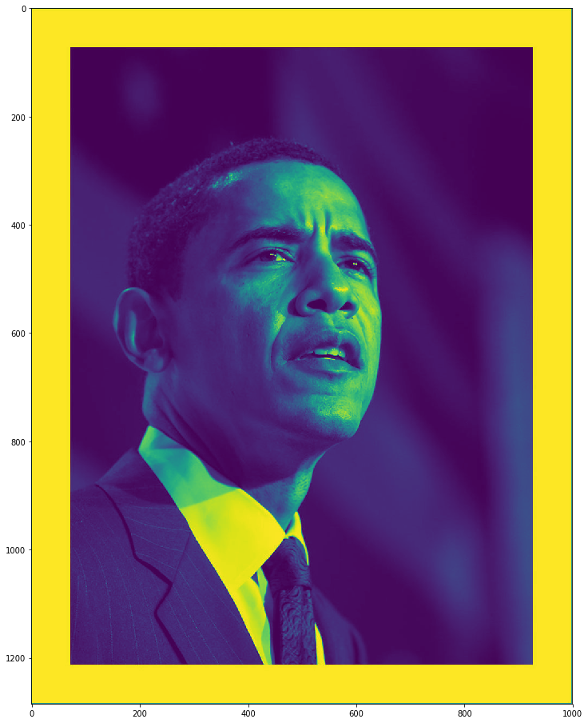
Principle Component Analysis

Slide 13
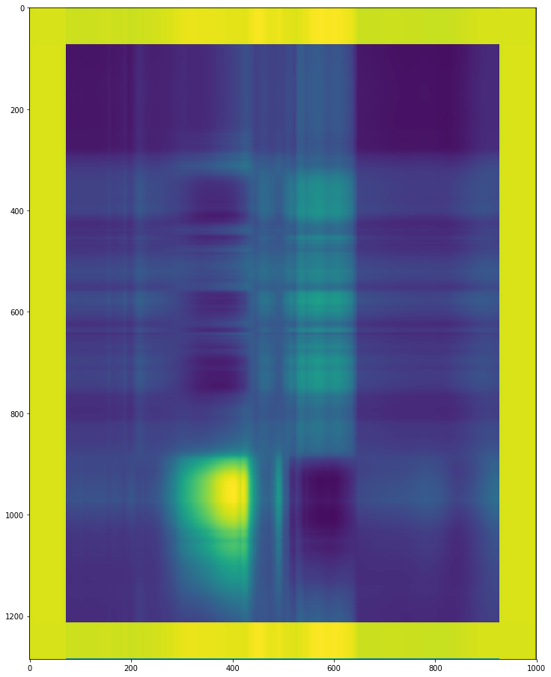
Principle Component Analysis-2PC

Slide 14
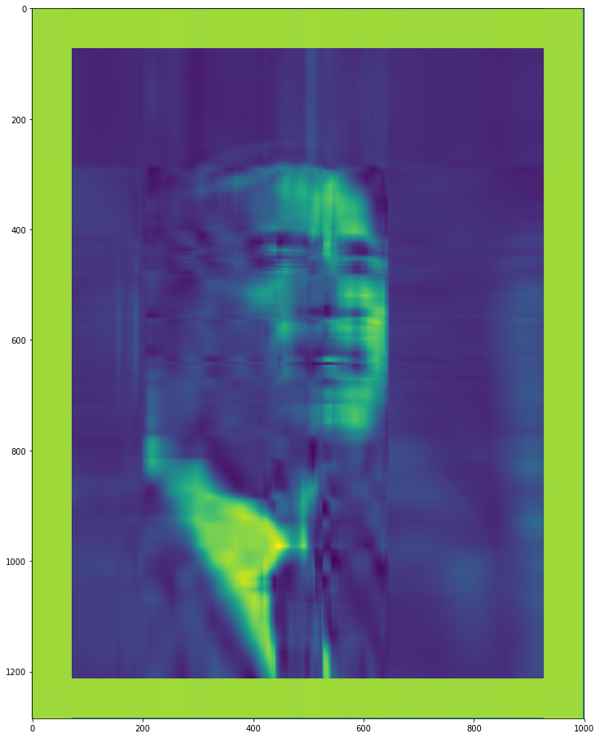
Principle Component Analysis-10PCs

Slide 15
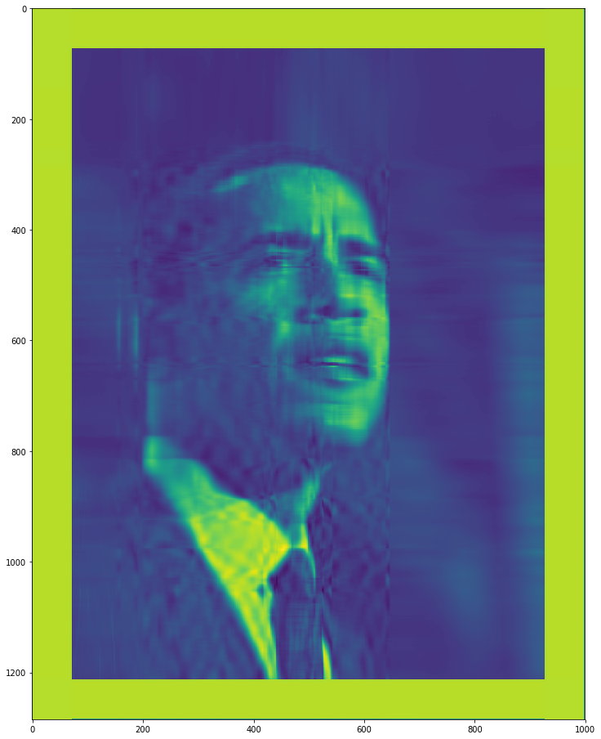
Principle Component Analysis-20PCs

Slide 16
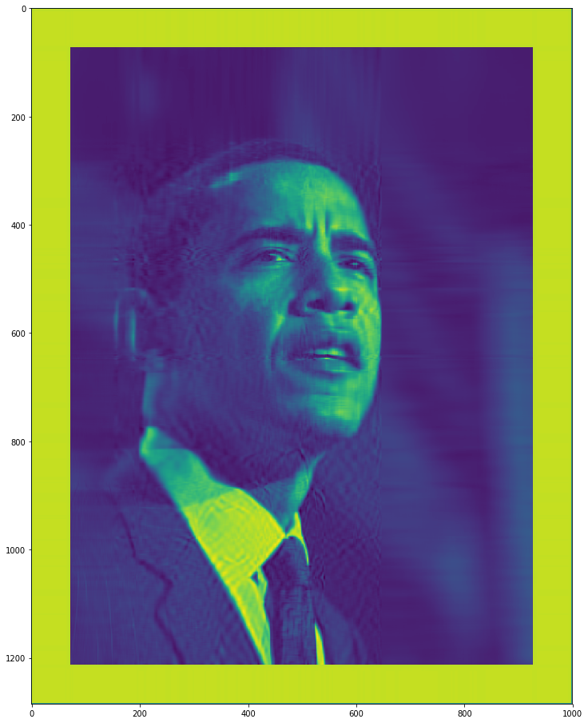
Principle Component Analysis-40PCs

Slide 17
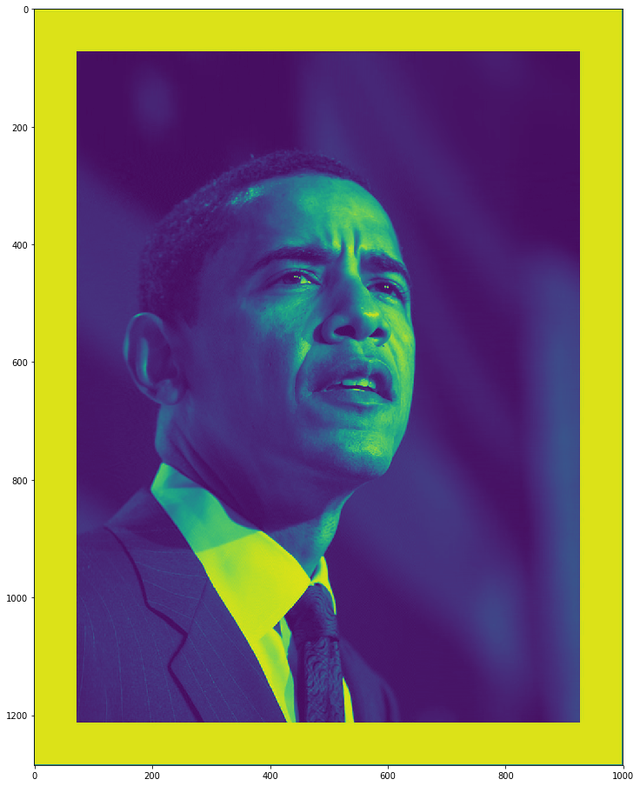
Principle Component Analysis-100PCs

Slide 18
Principle Component Analysis-1000PCs

Slide 19
t-Distributed Stochastic Neighbor Embedding (t-SNE)
tSNE
developed by Laurens van der Maaten and Geoffrey Hinton.
The technique is a variation of Stochastic Neighbor Embedding (Hinton and Roweis, 2002)
It is a non-linear embedding technique well-suited for embedding high-dimensional data for visualization in a low-dimensional space of two or three dimensions.
Can be found in python using sklearn.manifold.TSNE

Slide 20
Independent Component Analysis
ICA
Other linear projection methods that can be used for non-Gaussian distributed data include ICA and projection pursuit
ICA was proposed for blind source separation of signals. It finds projections that are independent and may not be orthogonal.
Projection pursuit uses a measure of “interestingness” of a projection which is a measure of some aspects of not being Gaussian (such as entropy). It tries to find projection that maximize the measure ( i.e getting away for Gaussian). Data is reduced by removing components along this projection.

Slide 22
That’s All Folks

